Slide 1
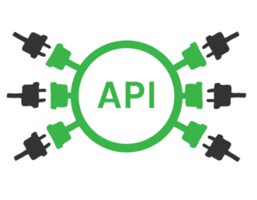
Final Project Data Programming
Group – 6

Slide 2





Our Team
Priyanshu Singla
[200522518]
Karan Upneja
[200520910]
Mehak Bansal
[200517430]
Dan Owusu
[200509756]
ROLE – DATA ANALYST
EDUCATION –
Mechanical Engineering Graduate
Worked as a Quality Assurance Engineer at Lumax Industries
ROLE – DEVELOPER
EDUCATION –
Bachelor in Information and Technology
Almost four years experience as a Software Developer at Capgemini
ROLE – BUSINESS ANALYST
EDUCATION –
Bachelor in Science [Non-Medical]
Six Months Training in Python
ROLE – PROJECT MANAGER
EDUCATION –
Bachelor in Mathematics and Business Management
Master in Applied Economics

Slide 3

PROJECT SUMMARY
Our dataset includes all information on the crypto-currencies listed on the WazirX exchange, including information about the opening and closing prices of various crypto coins as well as the volume exchanged over the span of 24 hours.
Additionally, we have bid and ask prices, and the data is in INR. There is more than 450 currencies data in our chosen dataset.
Variables:
symbol, baseAsset, quoteAsset, openPrice, lowPrice, highPrice, lastPrice, volume, bidPrice, askPrice, time stamp
TECHNOLOGIES USED:
Programming language - Python, JavaScript, HTML, CSS
Framework - Flask
Visualization - Google Charts
Database - MongoDB

Slide 4
WORKFLOW OF THE PROJECT:
Sourced the URL from the WazirX website
Acquired the data from the URL with the help of PYTHON and then stored the data in the MongoDB
Fetched data from MongoDB for cleaning process
Cleaned data was used for the visualization in the Google Charts ( JavaScript was used )
Built a connection between Google Charts and Flask in order to get a Dashboard
Deployed the Flask API on Google Cloud Platform (GCP)
Conducted a FIT GAP Analysis
Built an API in which:
All the items were fetched from MongoDB and displayed into a different section on our website
A range of items were fetched
Items were displaced by their respective ID

Slide 5

BUSINESS QUESTIONS
Q1. What are the most popular crypto-currencies right now?
Q2. Which coins have been the most profitable over the last 24 hours?
Q3. Which coins suffered a significant loss in a day?

Slide 6
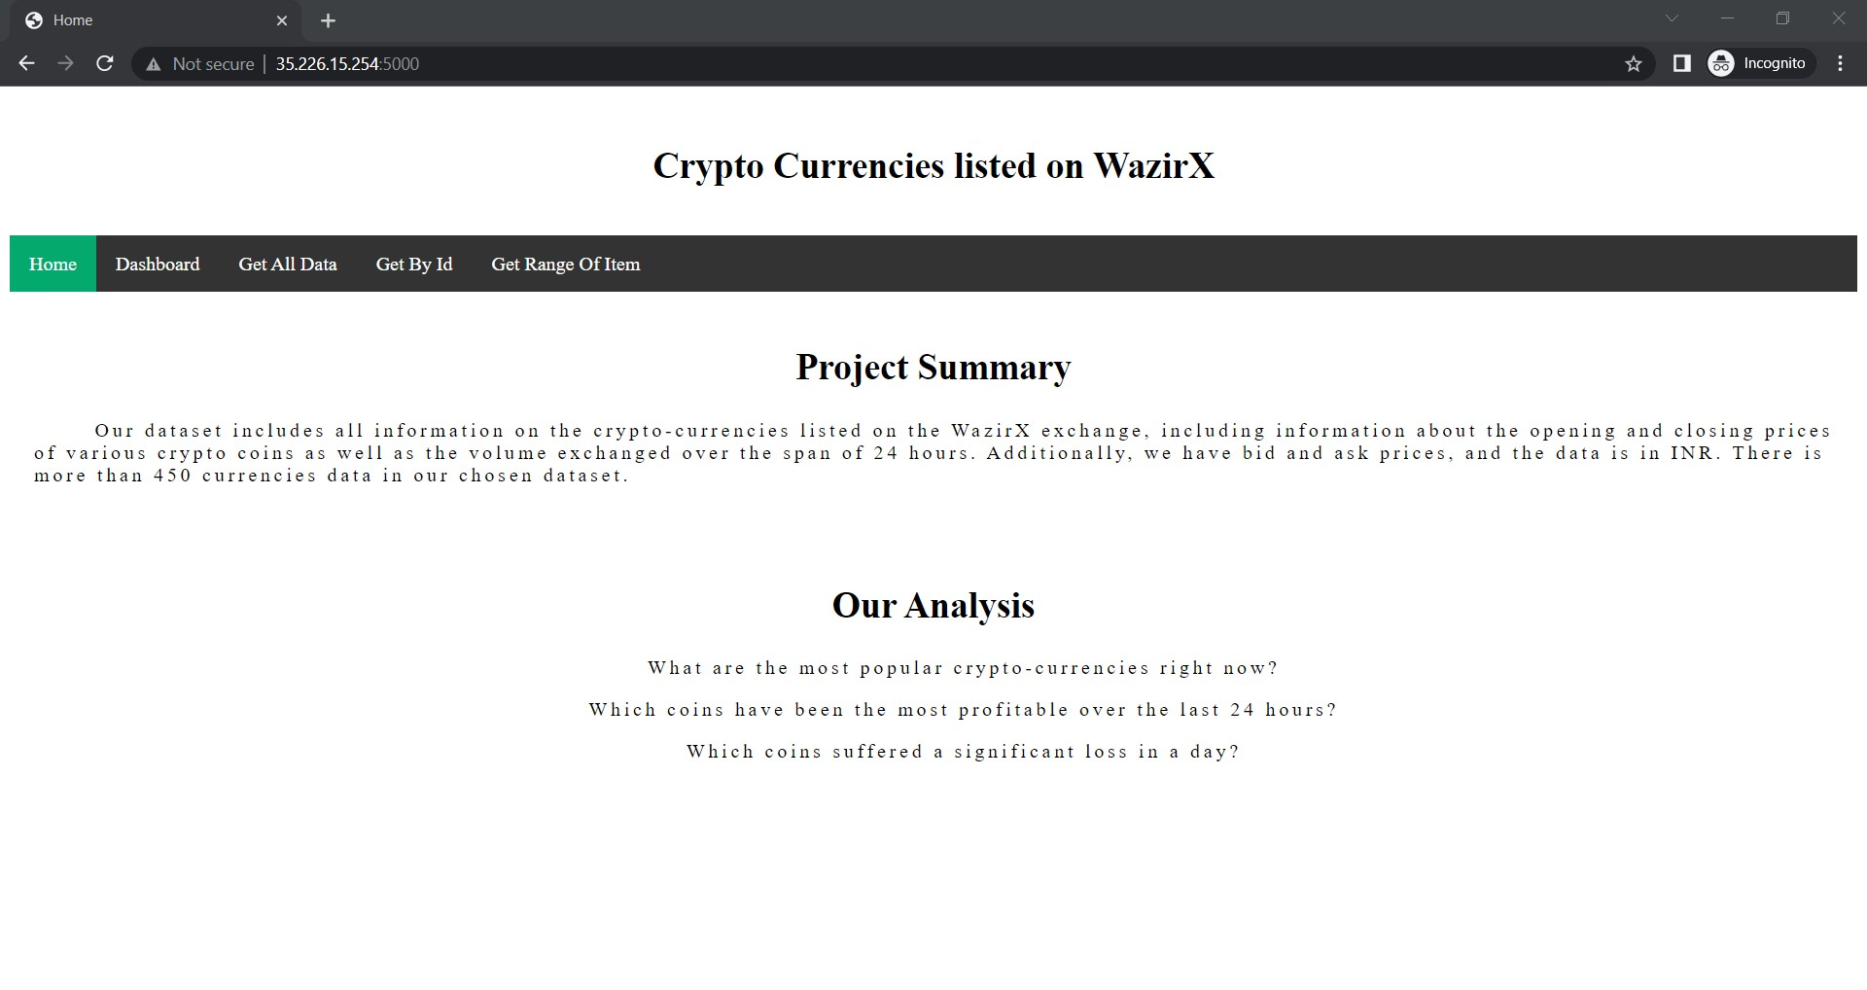
Demonstration – HOME PAGE

Slide 7
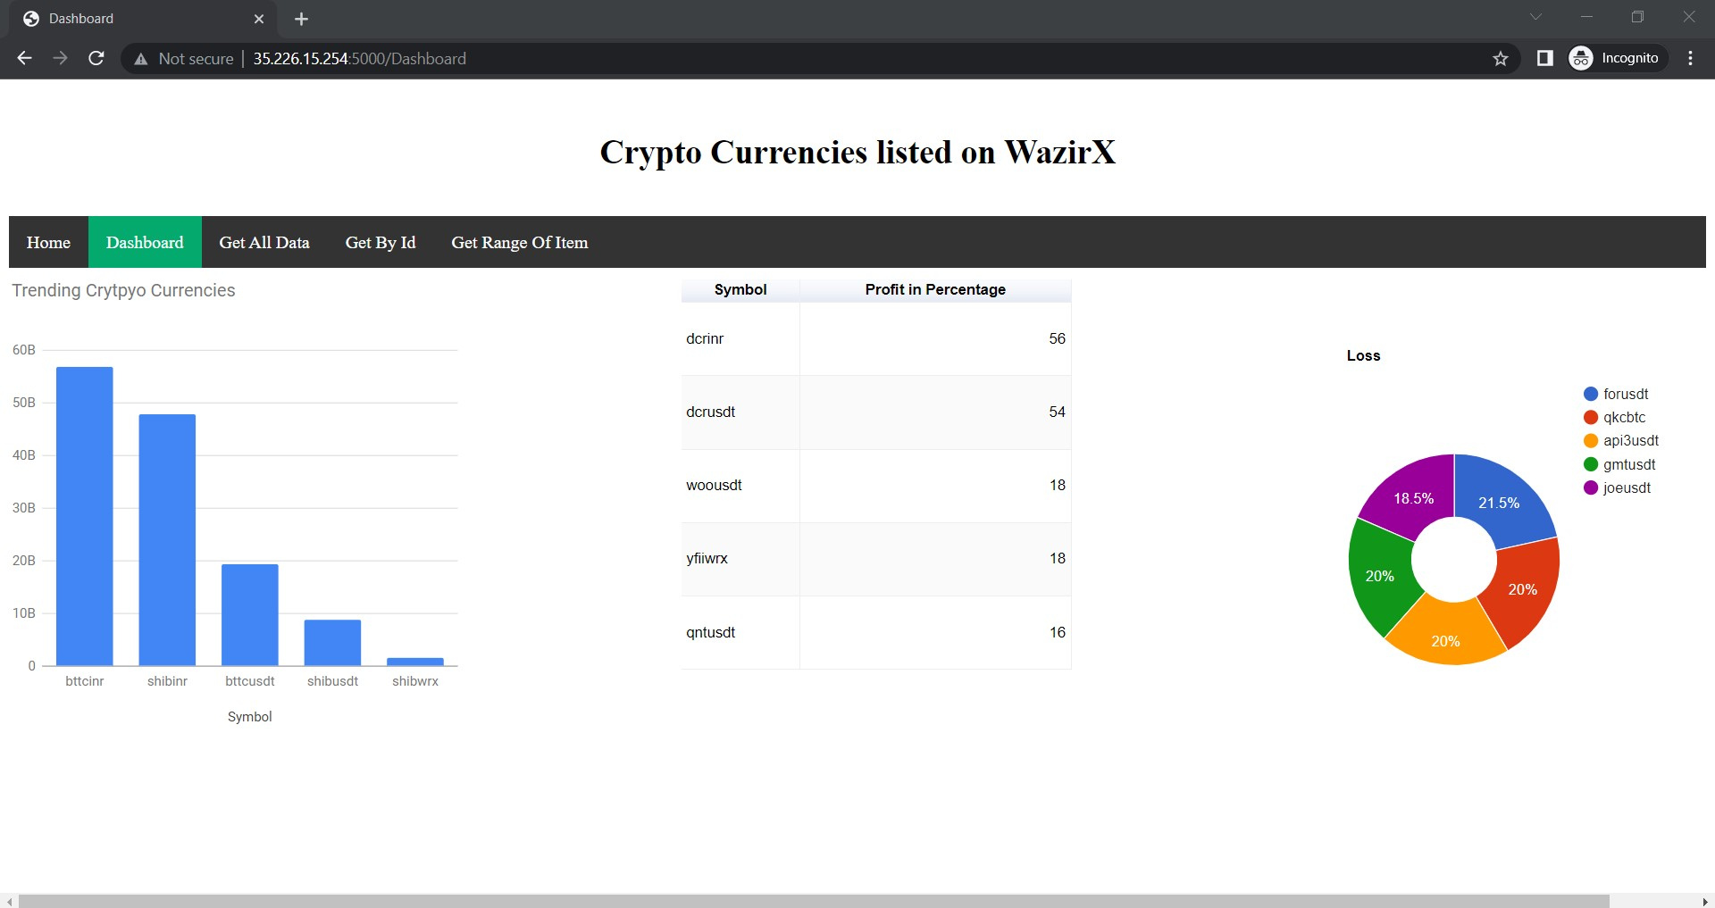
Demonstration - DASHBOARD

Slide 8

FIT GAP ANALYSIS
Our team was not able to run the server as the pseudo-batch was stuck in the loop
Solution – Kept the whole code ( data acquired from API, data inserted into MongoDB, pseudo-batch code) in a separate python file
The method which was inserting the data into the MongoDB was scheduled for 24 hours due to which the data wasn’t inserted into the database initially.
Solution – Data was inserted into MongoDB first and then we were able to run our pseudo batch

Slide 9

Any Questions ???
Thank You !!

